Slide 1
Predicting Stroke
By Steven Phillips

Slide 2

Problem: Predicting Stroke
The predictability of stroke amongst
individuals was explored in this analysis.

Slide 3
Data Set:
The data used for this project originates from:
(https://www.kaggle.com/datasets/fedesoriano/stroke-prediction-dataset)
The data set contained information from 5,110 individuals.
Several features, including age, gender, marital history, smoking status, and type of work, were part of the data set.
Other health indicators, including, whether or not the individual had a stroke were also available.

Slide 4
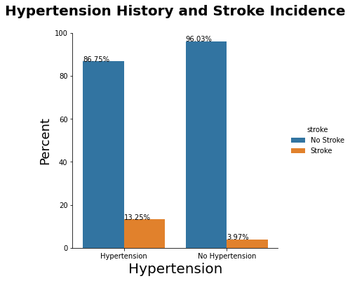
More than three times the incidence of stroke for those individuals with Hypertension
Very low percentage of Stroke for those individuals without Hypertension

Slide 5
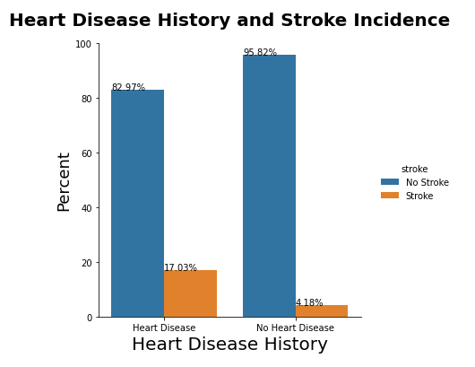
More than four times the incidence of stroke for those individuals with Heart Disease
Very low percentage of Stroke for those individuals without Heart Disease

Slide 6
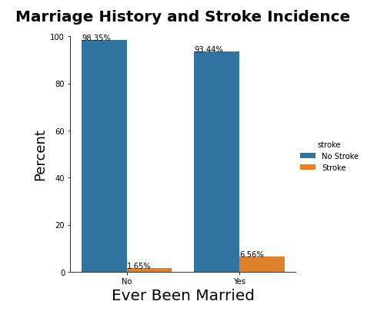
More than three times the incidence of stroke for those individuals who have ever been married
Very low percentage of Stroke for those individuals without a Marital History

Slide 7
Maching Learning Predictive Models Explored:
This was a problem of classification, predicting whether or not an individual would have a stroke. These models were considered:
Bagged Tree Classifier
Logistic Regression
LightGBM Classifier

Slide 8
Model 1: Bagged Tree Classifier
Great at overall predictions
.94 accuracy overall
Where did it fall short?
~ Taking on the challenge of an imbalanced data set.
(93.74% of the test data had the stroke condition.)

Slide 9
Model 2: Logistic Regression
Great at overall predictions initially, but where did it fall short?
Also, taking on the challenge of an imbalanced data set
How did it do after some tuning?
Accuracy suffered too much in comparison to the model ultimately chosen.

Slide 10
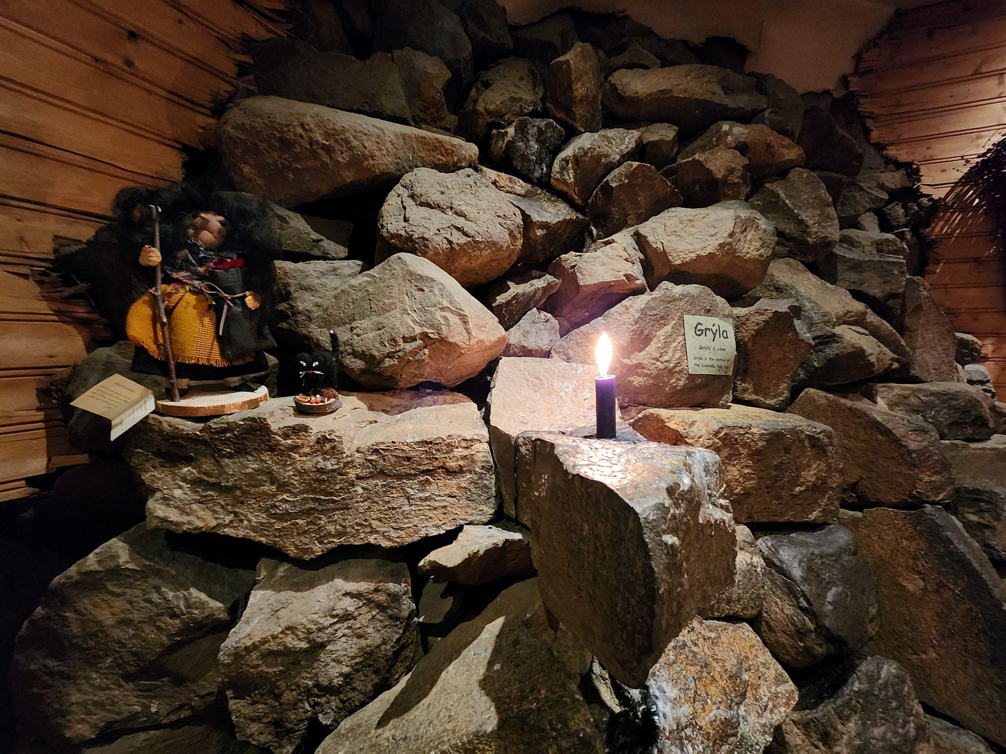
Model 3: Light GBM
Great at overall predictions initially.
Where did it fall short?
Initially, taking on the challenge of an imbalanced data set
How did it improve after some adjustments?
Improved performance dealing with the imbalance and better accuracy than other comparable models

Slide 11
Model Chosen for Production: LightGBM
Reduced False Negatives: RECALL 0.85
REDUCED PREDICTING NO STROKE FOR THOSE WITH STROKE RISK
Maintained decent overall predicting accuracy
ACCURACY OF 0.68
Additional metrics: Precision - 0.14, F1-Score - 0.25
Parameters of the model: Class weight - balanced, n_estimators - 50, num_leaves - 50, max_depth - 1

Slide 12
Final recommendations:
The stroke rate for individuals with a marriage history is higher and also for those with hypertension and heart disease. Treatments for this population may be considered to reduce their incidence of stroke.
Consider the LightGBM model for deployment in making decisions for the risk of stroke in individuals.

